Slide 1
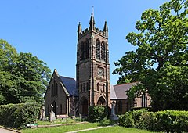
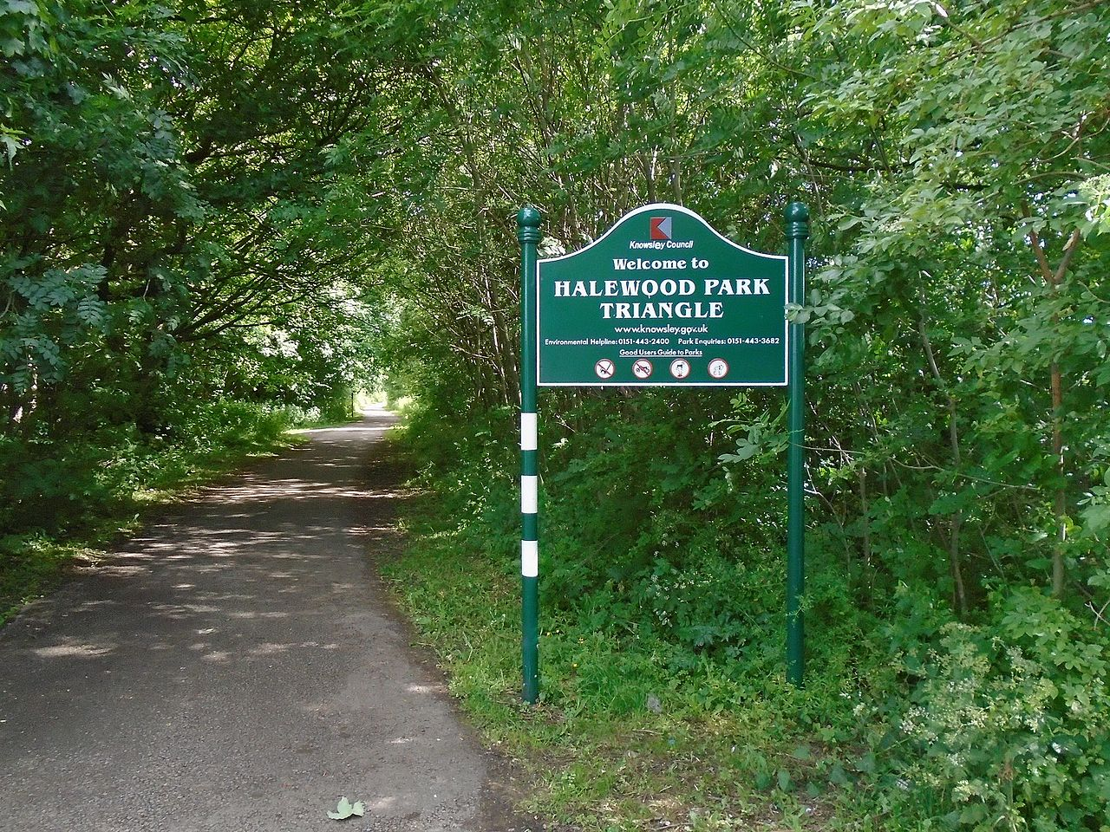
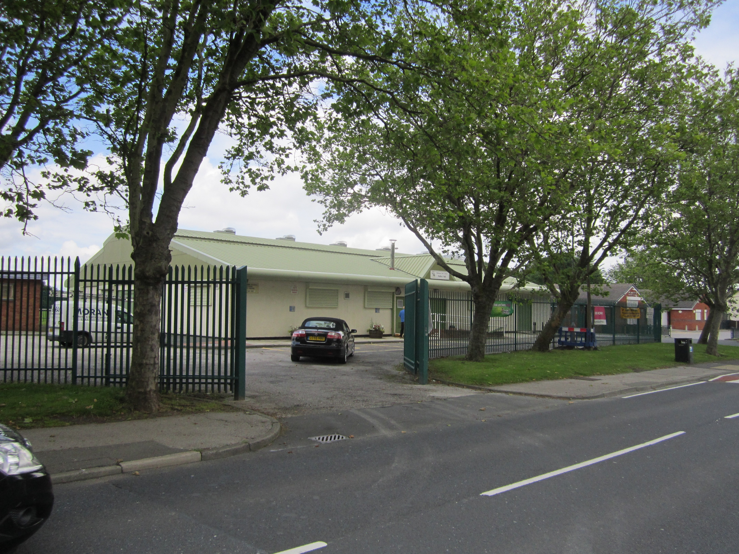
A Neighbourhood Plan for Halewood
Residents’ thematic working groups – January 2021
This Photo by Unknown Author is licensed under CC BY-SA

Slide 2
Welcome!
Today’s session aims to:
Present the findings from the residents’ survey.
Establish the thematic Working Groups. Identify membership of the Working Groups.
A forum to discuss the opportunities and challenges from developing a Neighbourhood Plan
Next Steps.

Slide 3
Why a Neighbourhood Plan for Halewood?
The major objections to the proposed sell-off of green space in 2018/19 propelled many in the community to organise against these proposals. As a future safeguard against some of these type of developments, a Neighbourhood Plan can give more control over such decisions.
The ‘new’ council elected in May 2019 set an objective of devising a Neighbourhood Plan to be adopted by the people of Halewood– if accepted via an eventual referendum.
Halewood Town Council is therefore leading the co-ordination of the Neighbourhood Plan on behalf of the township.

Slide 4
Consultation with Residents
A leaflet promoting Neighbourhood Plan consultation sessions was delivered to all Halewood households in September 2020 (over 8,500 households).
Nine consultation sessions were held with residents between Sept. 20th and October 31st. There was one ‘physical’ session; all others were held via Zoom. Some 1-to-1 telephone discussions were also held.
After the open sessions, local stakeholder groups/organisations were contacted regarding delivery of the presentation used in the consultation. Sessions were delivered to community groups, three political groups, a stakeholder group of Housing Associations, Headteachers from Halewood and a faith sector organisation.
Overall, 68 different persons attended at least one consultation session.

Slide 5
Consultation with Residents
A total of 59 surveys were returned following the consultation sessions providing a good depth of feedback about residents’ views. This included paper returns and completion of the form using ‘survey monkey’.
Four residents who took part in consultation sessions advised they did not wish to support the development of the Neighbourhood Plan (most wished us good luck, however!).
25 residents advised of their interest in supporting Halewood Town Council to develop a Neighbourhood Plan.
The majority of those 25 people are attending the sessions on January 19th. Two will require 1-to-1 calls due to their digital exclusion.

Slide 6
The Neighbourhood Plan Survey
The survey used to elicit views/comments from Halewood residents has provided a rich vein of information. It also helped to identify those local people interested in working with the Town Council to develop a Neighbourhood Plan
Selection of Comments from the Survey
1. Likes About Halewood
“What I like about living in Halewood is all of the Green Spaces”
‘Parks’ / ‘Green Spaces’
“Having a great GP Practice on my doorstep”
“Culturefest”
“Good Schools”
“Close to motorways networks” / “Good bus links”
“Friendly community” / “Strong community”
“People help each other”

Slide 7
2. Dislikes about Halewood/Places You Avoid
“Anti-social behaviour” (Off-road bikes/Gangs/Vandalism/Graffiti)
“Has been divisive in recent years”
“Social media in Halewood”
“Diversity is not welcomed”
“Lack of hospitality” (i.e. restaurants)
“Support services (Halewood people have to travel for i.e. domestic abuse support)”
“Loss of Green Spaces”
“Speeding vehicles”
‘Dog fouling’
“Housing developments” (multiple comments)

Slide 8
3. Three Words to Describe Halewood
‘My private space’
‘Has much potential!’
‘Deprived’
‘Potential’
‘Pleasant’
‘Vibrant’
‘Appealing’
‘Devalued’
‘Green’
‘Accessible’
‘Safe’
‘Community’
‘Suburban’
‘Quiet’

Slide 9
4. What would you change about the place?
‘More bio-diverse green spaces’
‘Maintain and protect parks and green spaces’
‘Improve the cycling provision’
‘Build more affordable homes’
’More sheltered housing’
’Housing for young people’
‘Don’t build shoebox houses’
‘Close the subway under Okell Drive’
‘More support for small businesses’
‘Pubs that serve better/nicer food’
‘More rubbish bins’

Slide 10
5. Key Issues for a Halewood Neighbourhood Plan
‘Environmental and Green Space protection’
‘Community Engagement’/’Community Involvement’
‘Transport improvements’
‘Housing’/’Infrastructure because of Housing developments’
‘Quality of houses being built’
‘Education’ (lack of 6th Form facility cited several times)
‘Improve Policing’
‘Heritage’
’Community facilities’
‘Hospitality and Leisure’
’Safe Play’ / ‘Safe Plays Areas for children’
’Mental Health’
‘Better access to GP’

Slide 11
Thematic Working Groups
The survey asked residents to name key themes of relevance for a Halewood Neighbourhood Plan. They were asked if they wished to participate in those thematic Working Groups.
The Thematic Working Groups suggested by residents were:
Heritage
Environment / Green Spaces
Transport
Community Engagement
Planning / Housing
Youth & Community
Policing
Education

Slide 12
Discussion and Forum for Ideas
Your opportunity for comments.

Slide 13
Questions and Comments
I will go to everybody in the meeting to ascertain your comments and views.
These were the questions sent to you on Saturday with the agenda
Any comments/feedback from the consultation sessions and the survey for the Neighbourhood Plan?
Are there any critical or important themes for the Halewood area missing from the list shared on Slide #10?
Which of the thematic Working Groups are of interest to you?
Would you have an interest in a co-leadership role in a Working Group (alongside either a Councillor or Staff Member)?
Any other comments?

Slide 14
Next Steps
The Neighbourhood Plan Steering Group will meet with its current membership to discuss and help form the proposed Working Groups and an expanded Steering Group
Gerry will contact you individually to invite you to join one (or more) of the Working Groups.
Some of you will be invited to act in a co-leadership role for a Working Group.
Dates and times for the first meetings of the Working Groups will be set. Also a date for the expanded Steering Group.
A report will be shared at the Town Council meeting of 15th March to update Councillors with progress. You are very welcome to attend this meeting.
A funding bid to central government will be written in March for submission in April. This is to draw down funding and technical support to assist with writing the plan.
A meeting scheduled with Maghull Town Council to hear about their experience and costs for developing a Neighbourhood Plan. You’re all be invited!

Slide 15
Thank-you for your participation today.

