Slide 1
Community Achievement Awards

Slide 4
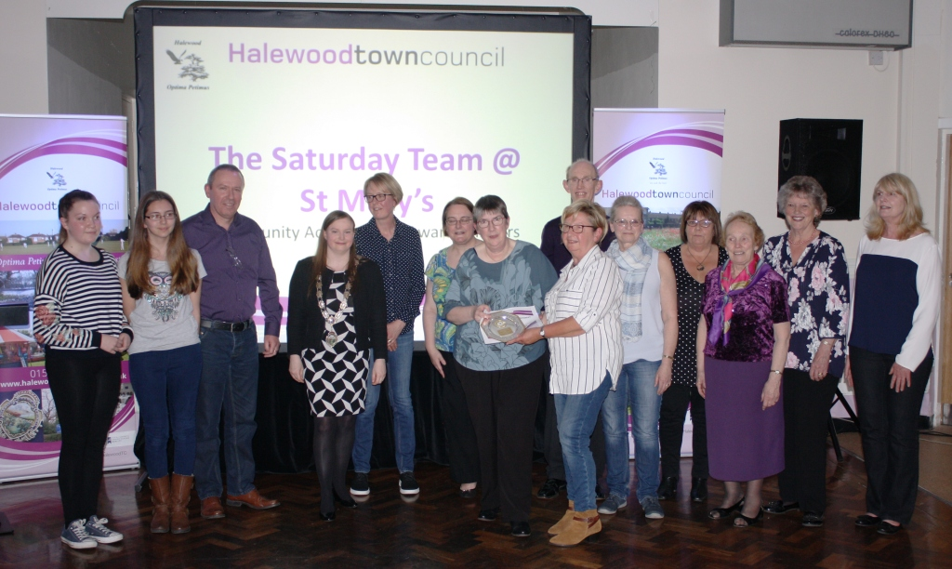

Slide 5
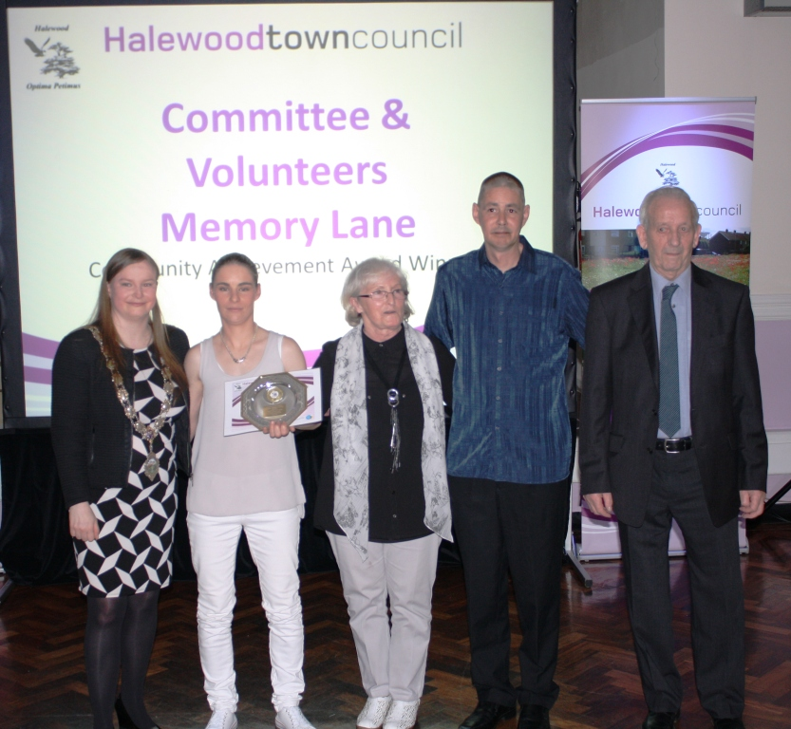

Slide 6
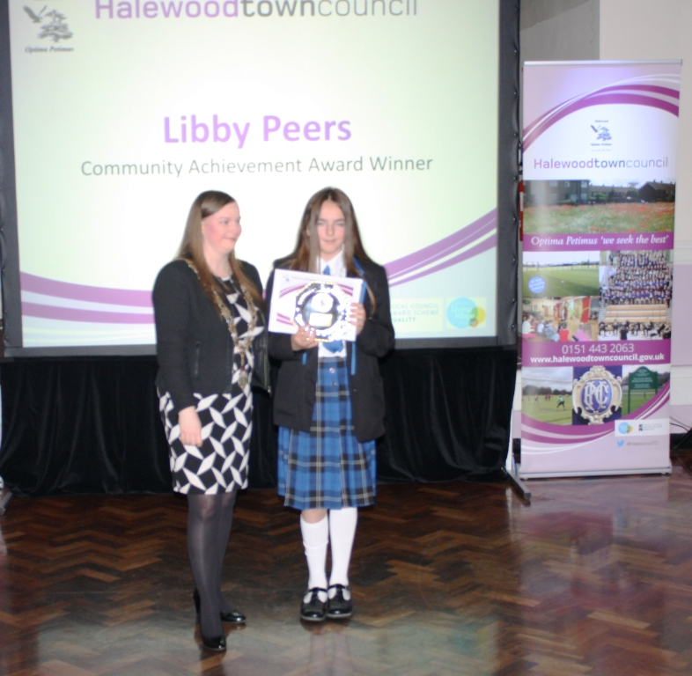

Slide 7
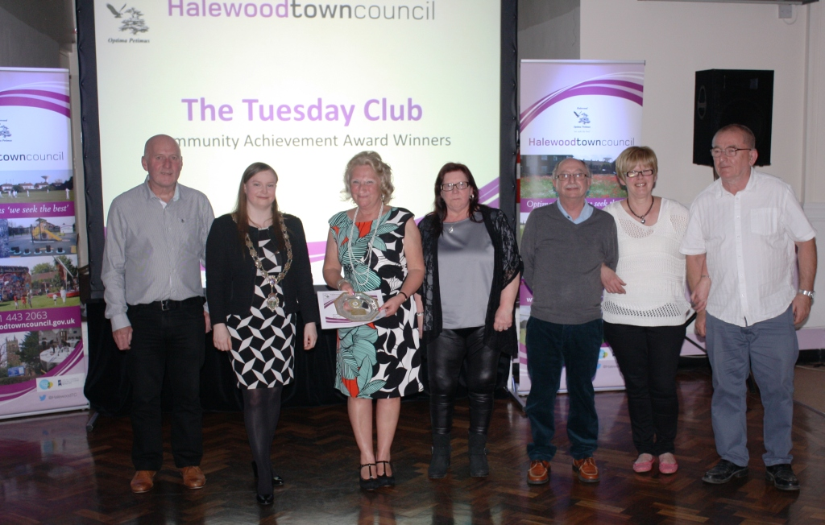

Slide 9
Special Recognition Award

Slide 10
